Slide 1
Exemplary CAR 153915609 Finding

Slide 2
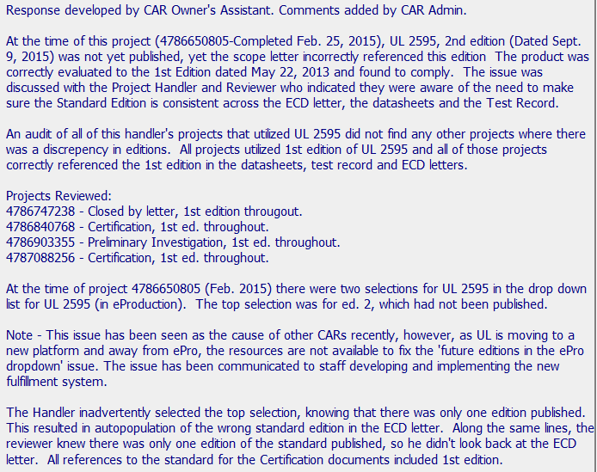


Exemplary CAR 153915609
Very thorough Analysis that completely covers the scope and explains that this systems issue has been seen in other CARs and details why it will not be addressed with an IT change.

Slide 3
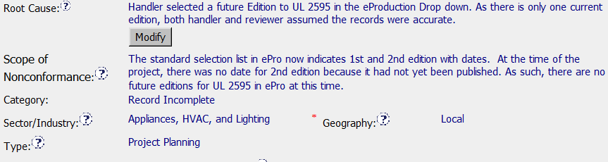
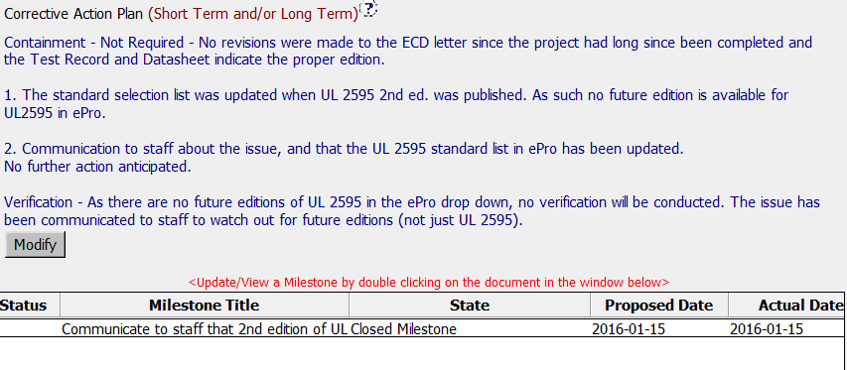

Exemplary CAR 153915609
2. Root cause is succinct, Scope of Nonconformance is clear and supported by Analysis, administrative fields are completed accurately.
3. Clear information is provided to explain why containment and verification are not required.

Slide 4
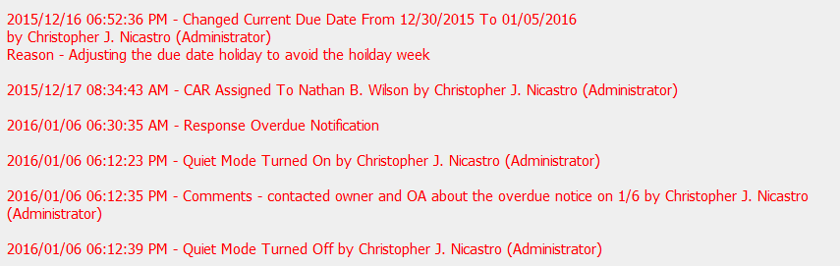

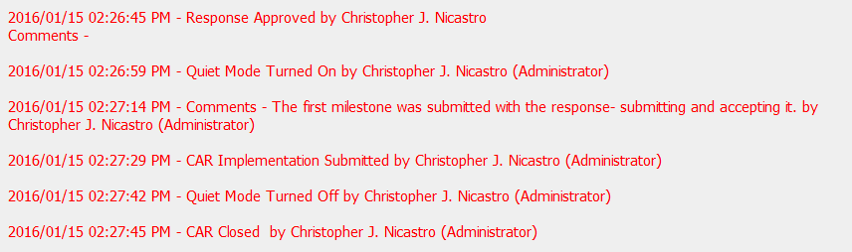
Exemplary CAR 153915609
4. The CAR was handled in a very timely manner and the Champion demonstrated Customer Focus by adjusting dates around the holidays, providing evidence of communication for overdue response and closing the CAR while approving the response, as the corrective action was already completed. This CAR is a great example of giving a CAR Owner the flexibility he needed, while ensuring compliance with our CAR requirements.

Slide 5


This CAR is a great example of giving a CAR Owner flexibility, while ensuring the integrity of the CAR process and compliance with CAR requirements were clearly documented.

Slide 6
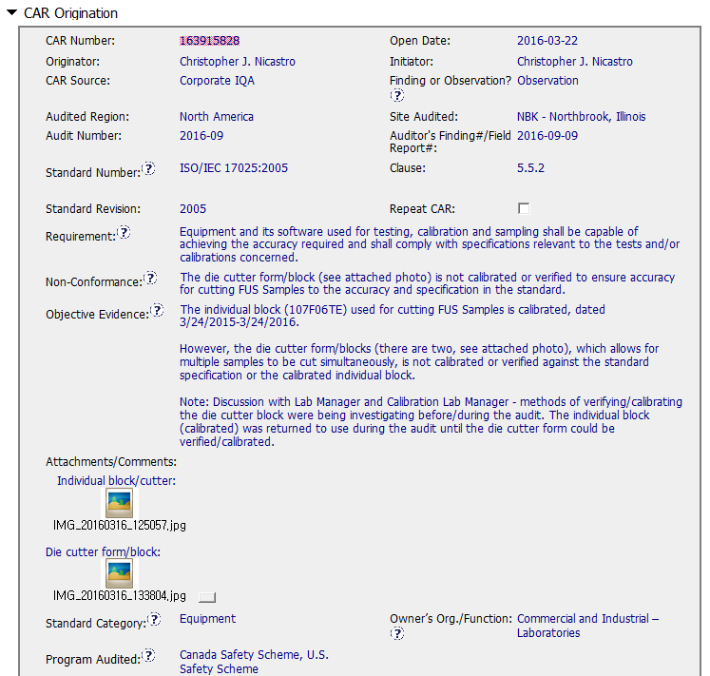
CAR 163915828
Observation
Equipment
Evidence –
The individual block (107F06TE) used for cutting FUS Samples is calibrated.
However the die cutter block, which allows for multi samples to be cut, is not calibrated or verified.

Slide 7
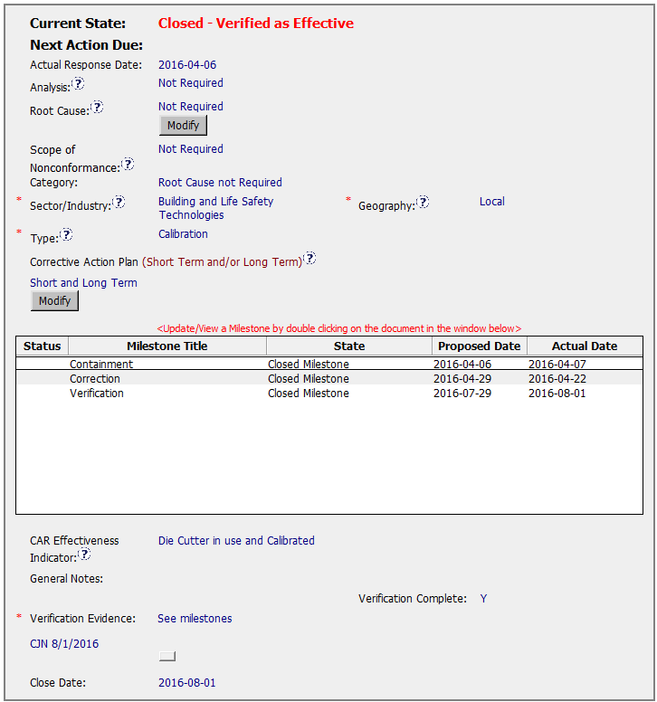
CAR 163915828
Observation - CAR
Excellent (1)
Analysis, Root Cause, Scope – “not applicable”
Category
- “Root Cause not Required”
Excellent (2)
Verification – occurred immediately after acceptance of the last milestone

Slide 8
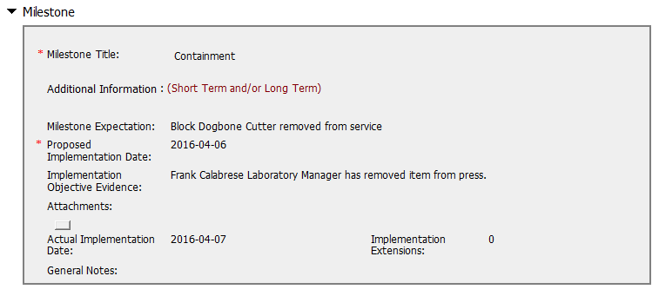
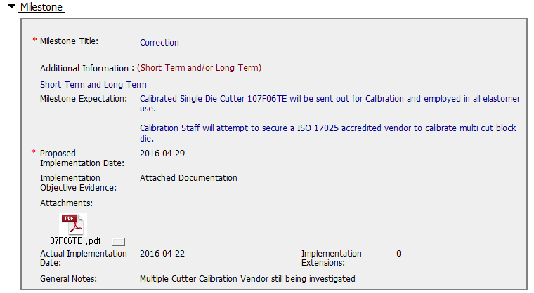
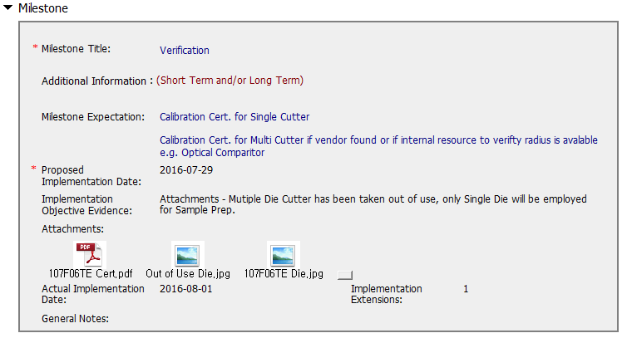
CAR 163915828
Excellent (3)
Milestones – completed per milestone expectations
Suggestion (1)
Objective Evidence - Indicating what kinds of objective evidences are attached clearly

Slide 9
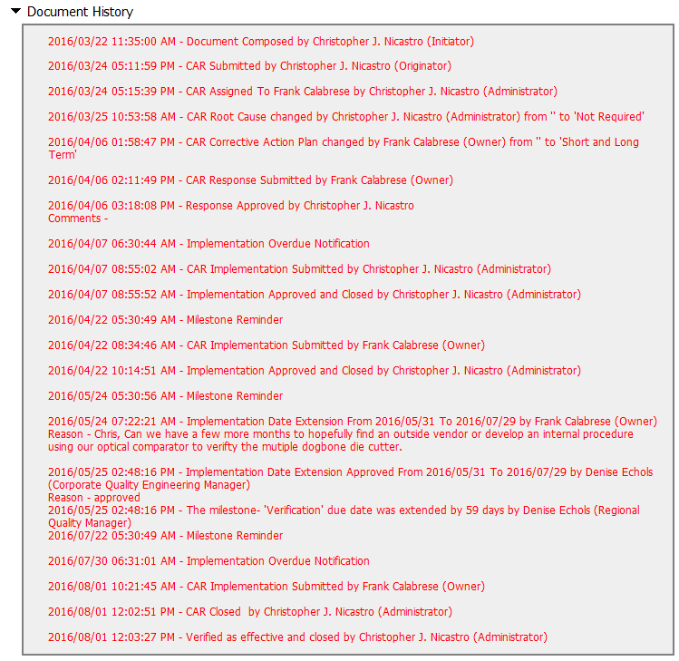
CAR 163915828 History Summary
Suggestion (2)
Extensions – within requirements (<30 days, 3 or less)

